Slide 1


FELIPE CEZAR
Figthing Corruption wih Machine Learning
Detecting Campaign Financing infractions In The 2018 Brazilian Elections

Slide 2

Corruption in the Age of AI
Corruption is a serious global problem, transcending borders, political
affiliations and systems of government. As more governments digitize their
operations, there is an increased opportunity to develop practical
anti-corruption tools based on big data, open data and artificial intelligence
US$1 trillion
Is the amount of government revenues that the IMF estimates to be lost every year globally with corruption

Slide 3


Why Brazil?
The combination of high availability of data and high levels of perceived
corruption make Brazil a particularly attractive case for the application
of AI for anti-corruption efforts.
High Open Data Ranking
High Perception of Corruption
Brazil is ranked 8th best in the World
Rated 4.6 out 5 in Perceived Corruption in Public Sector
Data from Global Open Data Index
https://index.okfn.org/
Data from Our World In Data
https://ourworldindata.org/corruption

Slide 4




Project Summary
Machine Learning Model trained with data downloaded and scrapped from Tribunal Superior Eleitoral (Superior Electoral Tribunal) websites
Around 26k candidacies for President, Governor, Senator, Member of Congress were used to train the model.
The goal of the model is to predict whether a given politician should be investigated for financial infractions

Slide 5





Data Overview
Candidates Assets
Campaign Finance
Personal and Candidacy information
Election Results
Court Cases

Slide 6


Personal and Candidacy Information
The data that identifies each candidate. It includes information such as:
+30% from last month
Home state
Age
Gender
Party affiliation and partnerships
Ethnicity
Professional, and education background

Slide 7


Candidates' Assets
The data lists a candidates’ total asset value as reported to the tax authorities
It also breaks down the total value by categories such as:
Real Estate
Onshore and offshore accounts
Shares
Jewelry, art collection

Slide 8


Campaign Finance
The data lists every inflow and outflow of funds reported for the campaign
In addition to the cashflows value, it also categorizes them in a variety of ways, including:
Origin of funds
Profile of donors
Type of receipt provided
Type of product or service provided

Slide 9

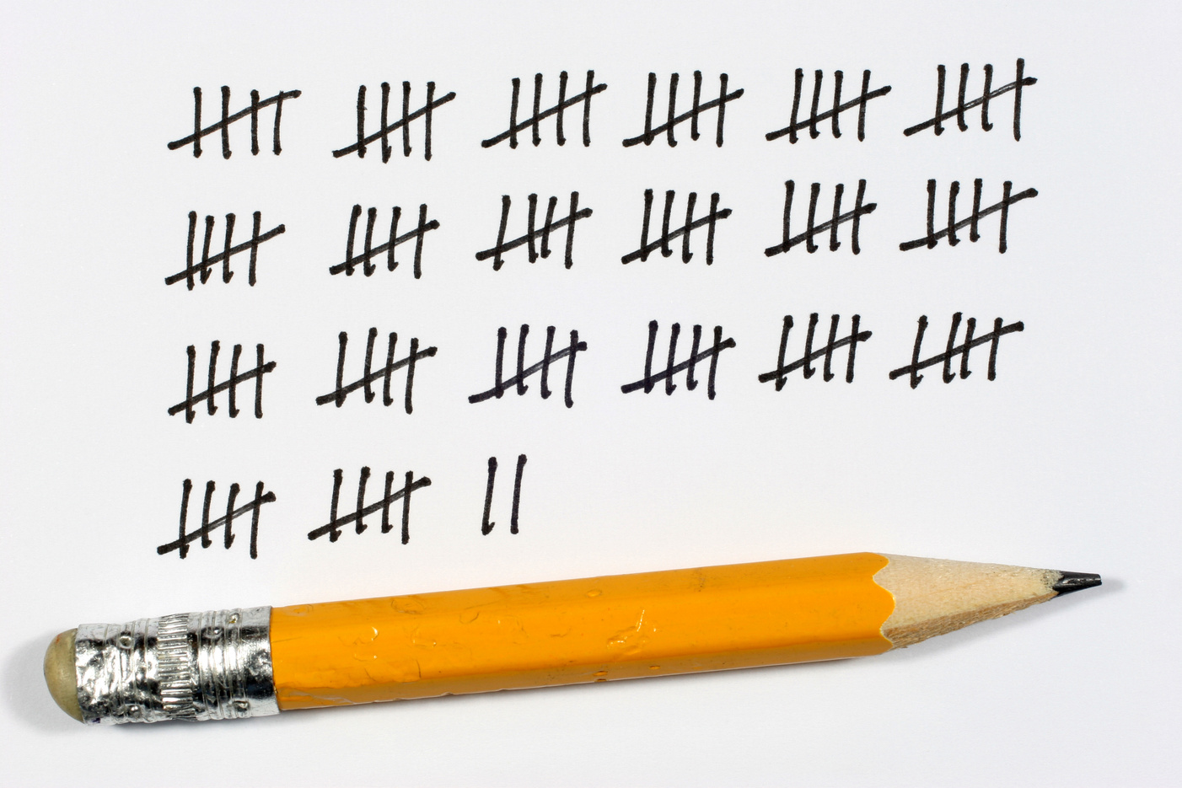
Election Results
The data lists the results from the election, pointing out who was elected for what, and how many votes they received
In addition to 2018, results from the 2014 and 2010 elections were also included to differentiate candidates based on previous performance

Slide 10


Court Cases
The data lists all court cases related to the 2018 elections, not just the ones about campaign finances
It shows which people and legal entities are involved in the case as well as the subject matter of the case

Slide 11

Machine Learning
1
Once all the data is obtained and cleaned, a model of supervised learning is built.
We indicate to the model which campaigns were involved in an enquiry about financial infractions, it then learns the patterns associated with them
2
Once it has been trained on a share of the data, it moves on to test its assumption on a different share. This is when we see how well it performs
3

Slide 12
Model Overview
A XGBoost model was trained to classify each campaign as "flagged" or "not flagged" for possible infractions
Out of a total of 26k campaigns in the dataset, 8.5k were involved in a court case related to their finances.
It was trained on around 18.2k datapoints and tested on 7.8k (70%/30%)
92.1%
84.3%
91%
accuracy
of actual infractions
of flagged campaigns
for all combined predictions
were flagged
had been involved in a court case

Slide 13
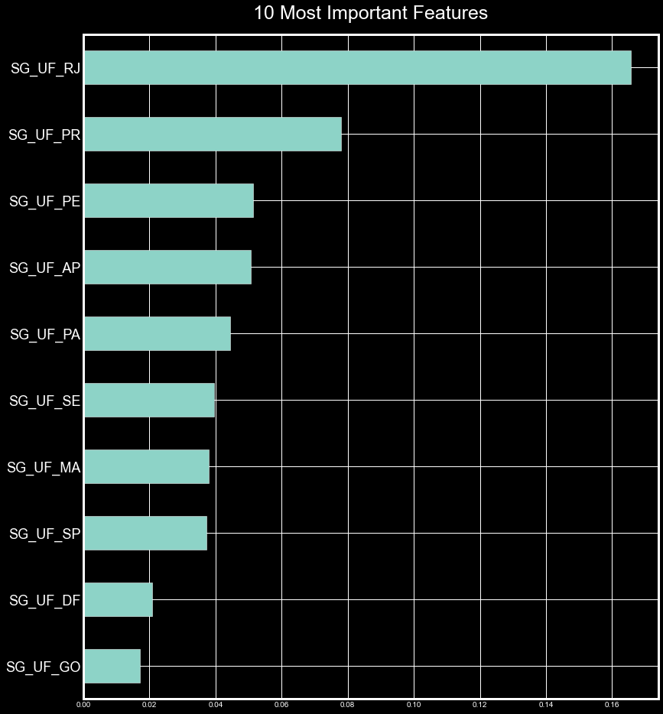
The importance score of a feature relates to how much that attribute is used to make key decisions with decision trees.
Most Important Features
The State where the campaign was held was found to be the most important features in determining whether the campaign should be flagged for possible infraction

Slide 14
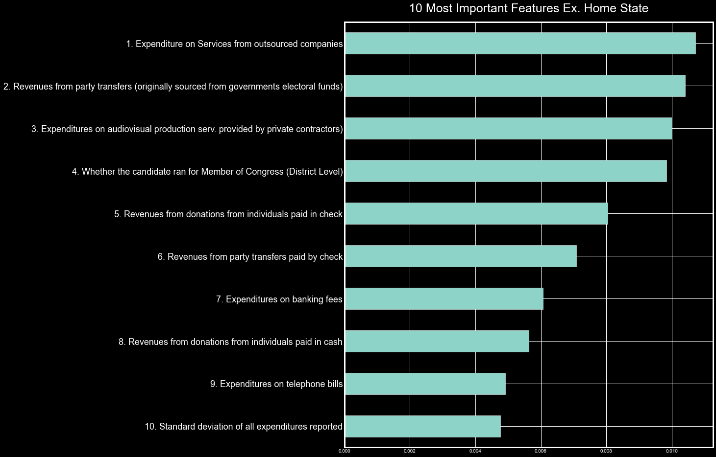
Most Important Features
exc. Home States
Once we exclude the States from the list, we find that it the amounts spent or received in specific ways are the most important features.
For example, ranked as number 1 in the chart below we see the amount spent in services from outsourced companies. Following that we see amounts of revenues received as donations from other political parties, sourced from government electoral funds.

Slide 15
Further Research
Explore court cases with different subject matter
Reclassify court cases with a Natural Language Processing and clustering models in order to use them as new infraction flags
Build unsupervised learning models that look for anomalies in the data

Slide 16
Thank you!
fc.felipecezar@gmail.com
https://www.linkedin.com/in/felipecezar1/?locale=en_US

